Slide 1
Mohammed Yasser
Mostafa Ashraf
Abdallah Ahmed
Work Team
Section Team
Abd-Elrahman Yehya
Adel Farooq
Adham Sayed
Ziad Mostafa
Nasr-Eldeen Elwazery
Start
Ziad Elshafai
Abd-Elmalek Mohammed
Rahma Ayman
Mohammed Ahmed
Ahmed Yosri
Youssef Mohammed
Mohammed Gamal
Ahmed Essam
Saleh Sayed
Mahmoud Mohammed
Bassem Rafiq
Youssef Osama
Kerolos Ibrahim
Mahmoud Mamdoh
Mahmoud Elsayed
Abd-Elrahman Diaa
Ibrahim Magdy
Mohammed Salem
Mahmoud Safwat
Fatma Sameh
Aya Elsayed
Gana Mohammed
Fatima Sharif

Slide 2
Work Team
Abd-Elrahman Yehya
Mohammed Yasser
Mostafa Ashraf
Abdallah Ahmed
Adel Farooq
Adham Sayed
Rahma Ayman
Gana Mohammed
Aya Elsayed
Fatma Sameh
Fatima Sharif
Section Team
Nasr-Eldeen Elwazery
Ahmed Essam
Saleh Sayed
Mahmoud Mohammed
Bassem Rafiq
Start
Ziad Elshafai
Youssef Osama
Kerolos Ibrahim
Mahmoud Mamdoh
Mahmoud Elsayed
Abd-Elmalek Mohammed
Abd-Elrahman Diaa
Ibrahim Magdy
Mohammed Salem
Mahmoud Safwat
Ziad Mostafa
Youssef Mohammed
Ahmed Yosri
Mohammed Ahmed
Mohammed Gamal

Slide 3
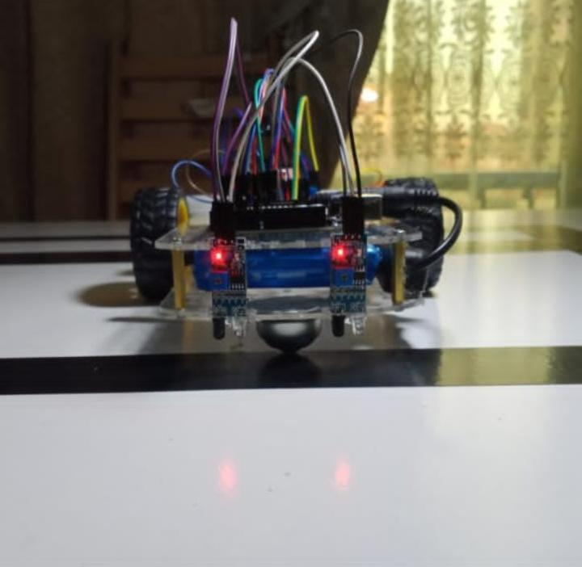
Robot line follwer
Introduction
​A Line Follower Robot is an autonomous vehicle designed to follow a predefined black line drawn over a white surface. The robot relies on infrared (IR) sensors to detect the path by distinguishing between the dark line and the bright background. Its operation is based on the scientific behavior of light reflection and absorption, where different colors reflect or absorb light in different ways. This contrast allows the robot to recognize the path and maintain accurate movement along it.

Slide 4
Robot line follwer
Introduction
​A Line Follower Robot is an autonomous vehicle designed to follow a predefined black line drawn over a white surface. The robot relies on infrared (IR) sensors to detect the path by distinguishing between the dark line and the bright background. Its operation is based on the scientific behavior of light reflection and absorption, where different colors reflect or absorb light in different ways. This contrast allows the robot to recognize the path and maintain accurate movement along it.

Slide 5
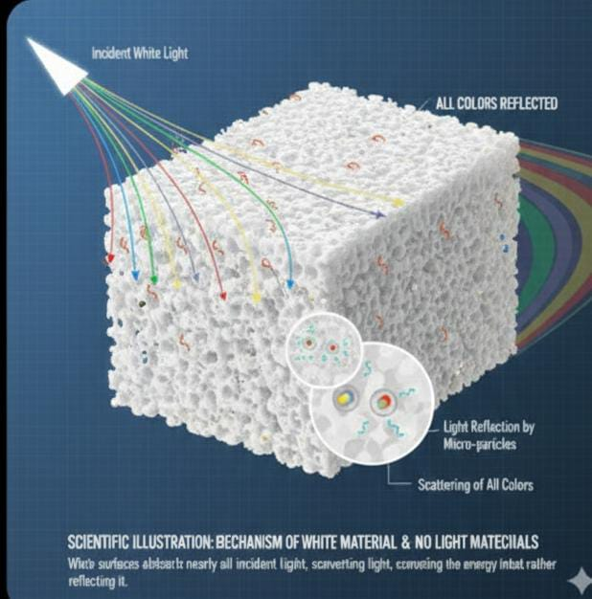
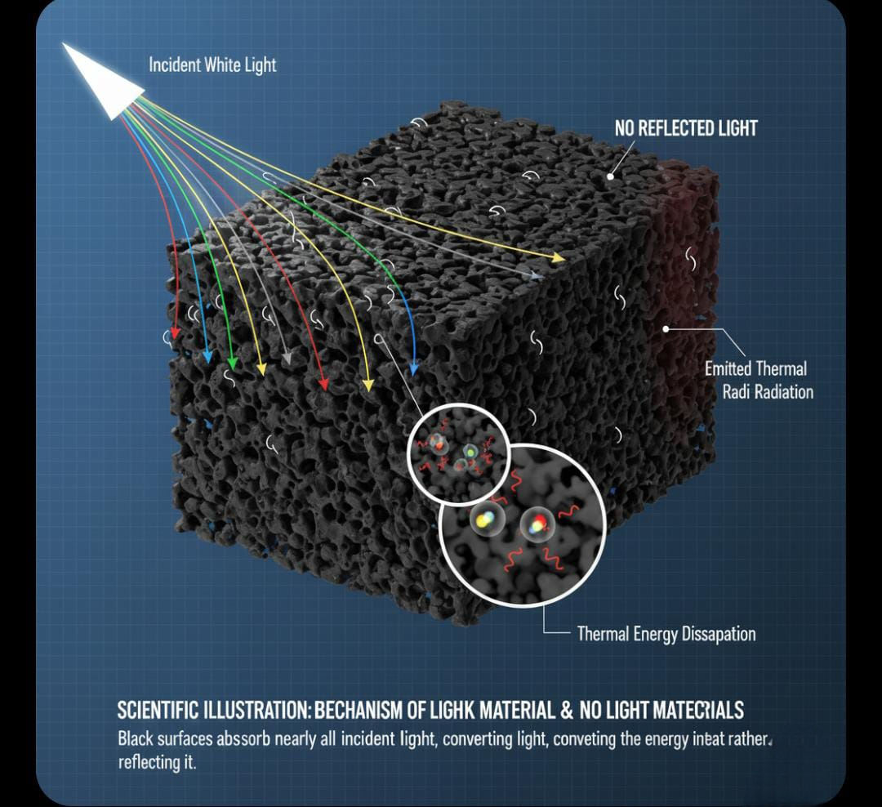
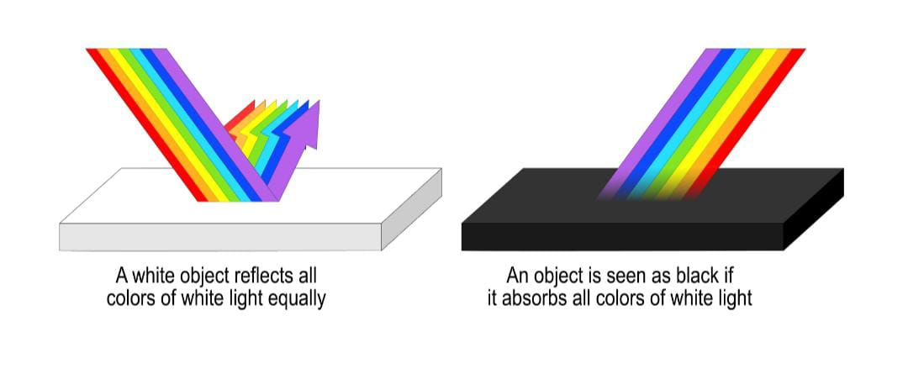
Working Principle )Light Reflection , and Absorption(
The robot’s behavior depends on how surfaces interact with infrared light. Each IR sensor consists of:
​an IR LED (emitter) that sends infrared light toward the ground,
​and a photodiode/phototransistor (receiver) that measures the reflected light.
a) Reflective Surface (White Background)
​White or light-colored surfaces reflect a large amount of IR light.
​The reflected light returns strongly to the sensor.
​The sensor produces a high signal, indicating the robot is off the black line.
b) Absorptive Surface (Black Line)
​Black surfaces absorb most of the IR light.
​Very little light returns to the sensor.
​The sensor outputs a low signal, indicating the robot is on the line.
Result:
​The robot continuously compares the sensor signals:
​High signal → white → adjust direction away
​Low signal → black → correct position back to the line
​This allows the robot to track the path precisely.

Slide 6
Working Principle )Light Reflection , and Absorption(
The robot’s behavior depends on how surfaces interact with infrared light. Each IR sensor consists of:
​an IR LED (emitter) that sends infrared light toward the ground,
​and a photodiode/phototransistor (receiver) that measures the reflected light.
a) Reflective Surface (White Background)
​White or light-colored surfaces reflect a large amount of IR light.
​The reflected light returns strongly to the sensor.
​The sensor produces a high signal, indicating the robot is off the black line.
Result:
​The robot continuously compares the sensor signals:
​High signal → white → adjust direction away
​Low signal → black → correct position back to the line
​This allows the robot to track the path precisely.
b) Absorptive Surface (Black Line)
​Black surfaces absorb most of the IR light.
​Very little light returns to the sensor.
​The sensor outputs a low signal, indicating the robot is on the line.

Slide 7
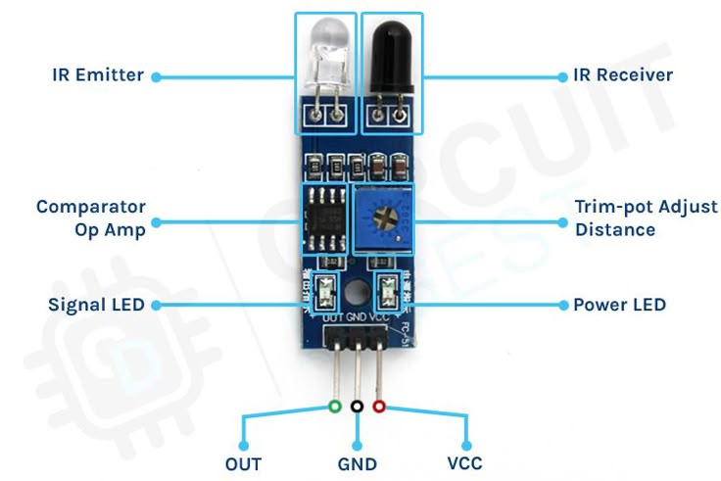
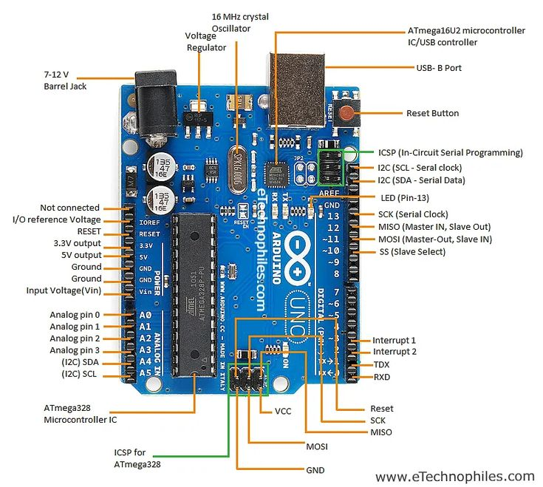
​1) IR Sensors (Infrared Sensors)
​Function: Detect the black line by measuring the reflection of IR light from the surface.
​Role: Provide HIGH/LOW signals to the controller depending on the surface color.
2) Arduino Board
​Function: Acts as the main controller of the robot.
​Role: Receives signals from IR sensors and makes decisions to control the motors according to the programmed code.
Components Used in the Line Follower Robot

Slide 8
Components Used in the Line Follower Robot
​1) IR Sensors (Infrared Sensors)
​Function: Detect the black line by measuring the reflection of IR light from the surface.
​Role: Provide HIGH/LOW signals to the controller depending on the surface color.
2) Arduino Board
​Function: Acts as the main controller of the robot.
​Role: Receives signals from IR sensors and makes decisions to control the motors according to the programmed code.

Slide 9
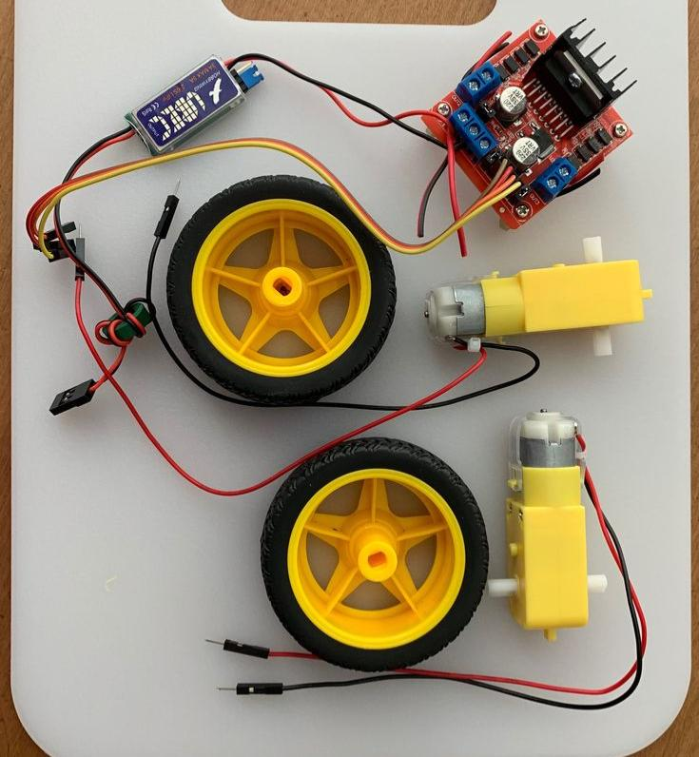
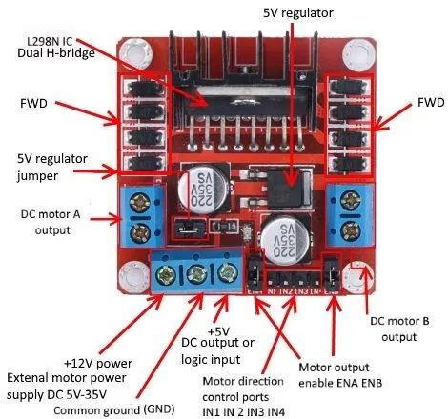
4) DC Motors
​Function: Convert electrical energy into rotational motion.
​Role: Drive the robot’s wheels.
​If both motors run at the same speed → robot moves straight.
​If one motor is faster → robot turns.
3) Motor Driver (L298N / L298D)
​Function: Supplies the required current and voltage to the motors since the Arduino cannot drive them directly.
​Role: Controls motor direction (forward/backward/left/right) and speed using PWM.

Slide 10
3) Motor Driver (L298N / L298D)
​Function: Supplies the required current and voltage to the motors since the Arduino cannot drive them directly.
​Role: Controls motor direction (forward/backward/left/right) and speed using PWM.
4) DC Motors
​Function: Convert electrical energy into rotational motion.
​Role: Drive the robot’s wheels.
​If both motors run at the same speed → robot moves straight.
​If one motor is faster → robot turns.

Slide 11
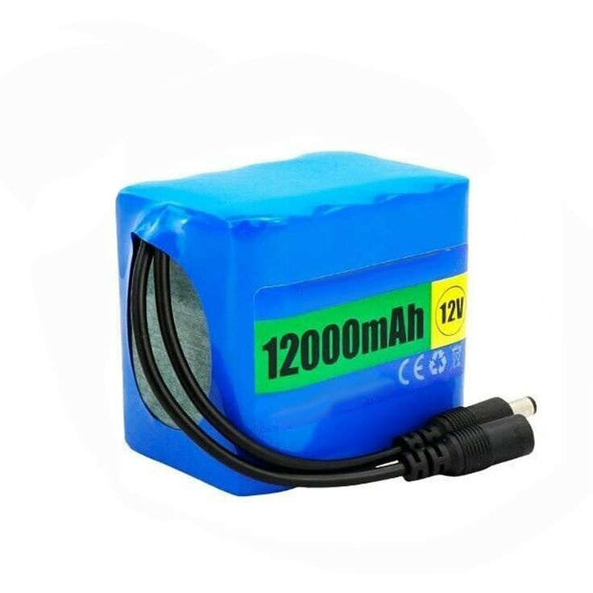
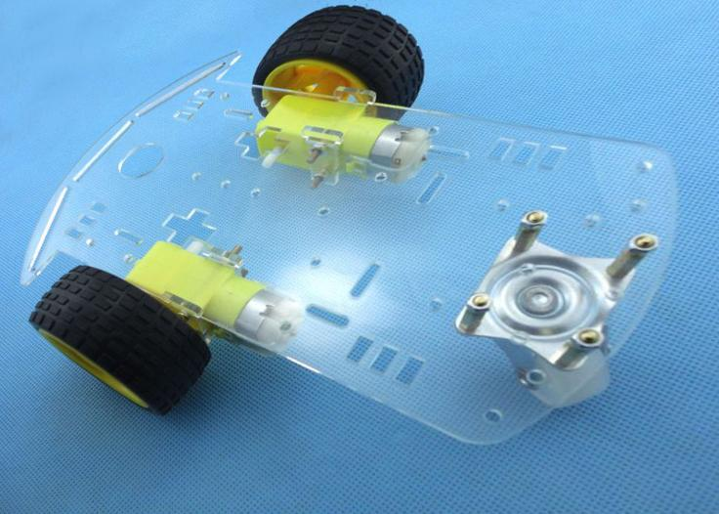
5) Battery Pack
Function: Provides the electrical power needed for all components.
Role: Feeds the Arduino, motor driver, and motors with proper voltage and current.
6) Robot Chassis
Function: Holds all mechanical and electronic components together.
Role: Provides structural stability and balance while the robot is moving.

Slide 12
5) Battery Pack
Function: Provides the electrical power needed for all components.
Role: Feeds the Arduino, motor driver, and motors with proper voltage and current.
6) Robot Chassis
Function: Holds all mechanical and electronic components together.
Role: Provides structural stability and balance while the robot is moving.

Slide 13

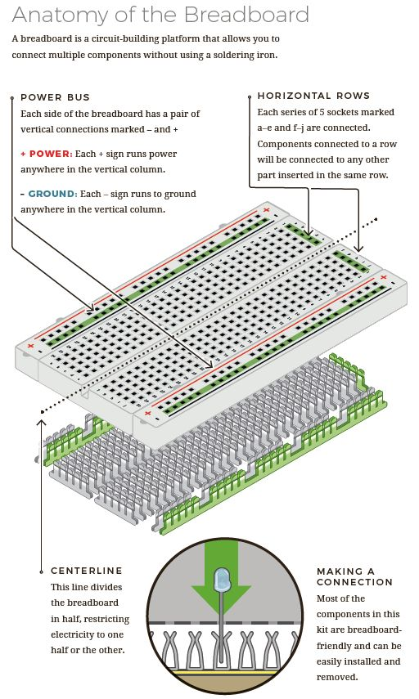
7) Breadboard (Bridge Board)
Function: Used for easy wiring and connecting components without soldering.
Role: Helps distribute power and connect sensors, motors, and the controller quickly during prototyping.

Slide 14
7) Breadboard (Bridge Board)
Function: Used for easy wiring and connecting components without soldering.
Role: Helps distribute power and connect sensors, motors, and the controller quickly during prototyping.

Slide 15

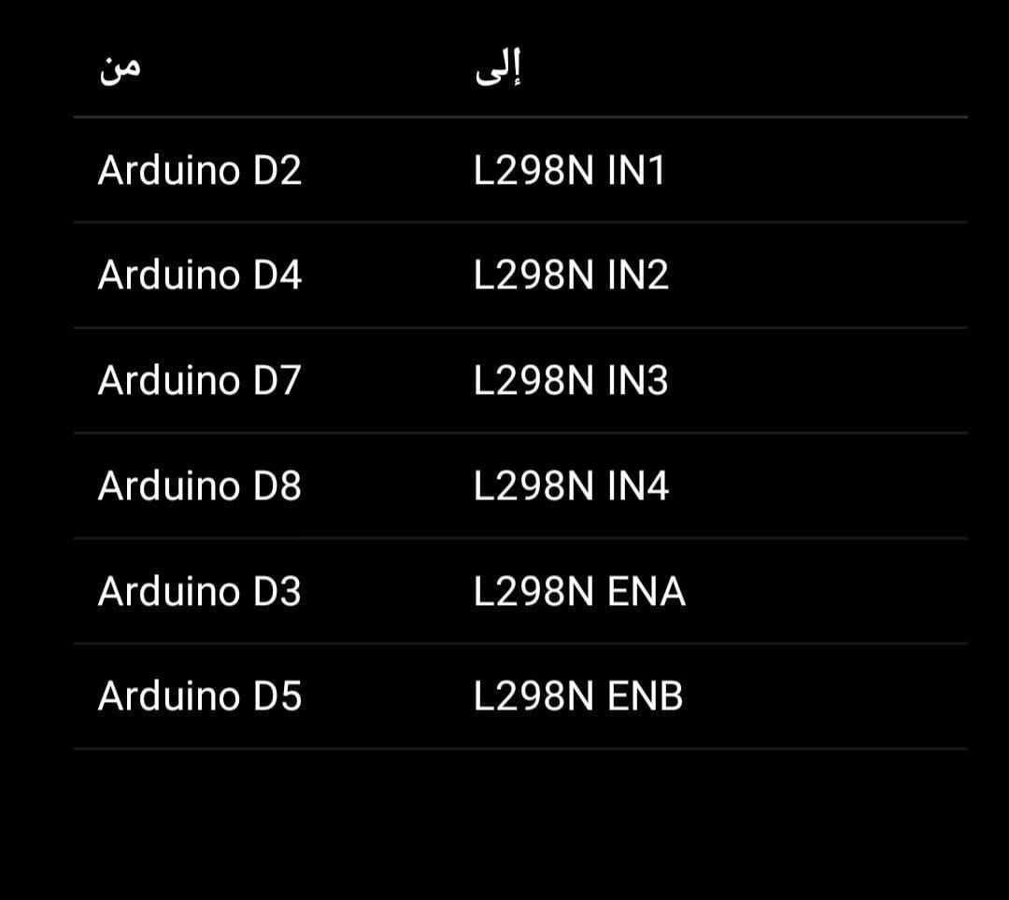
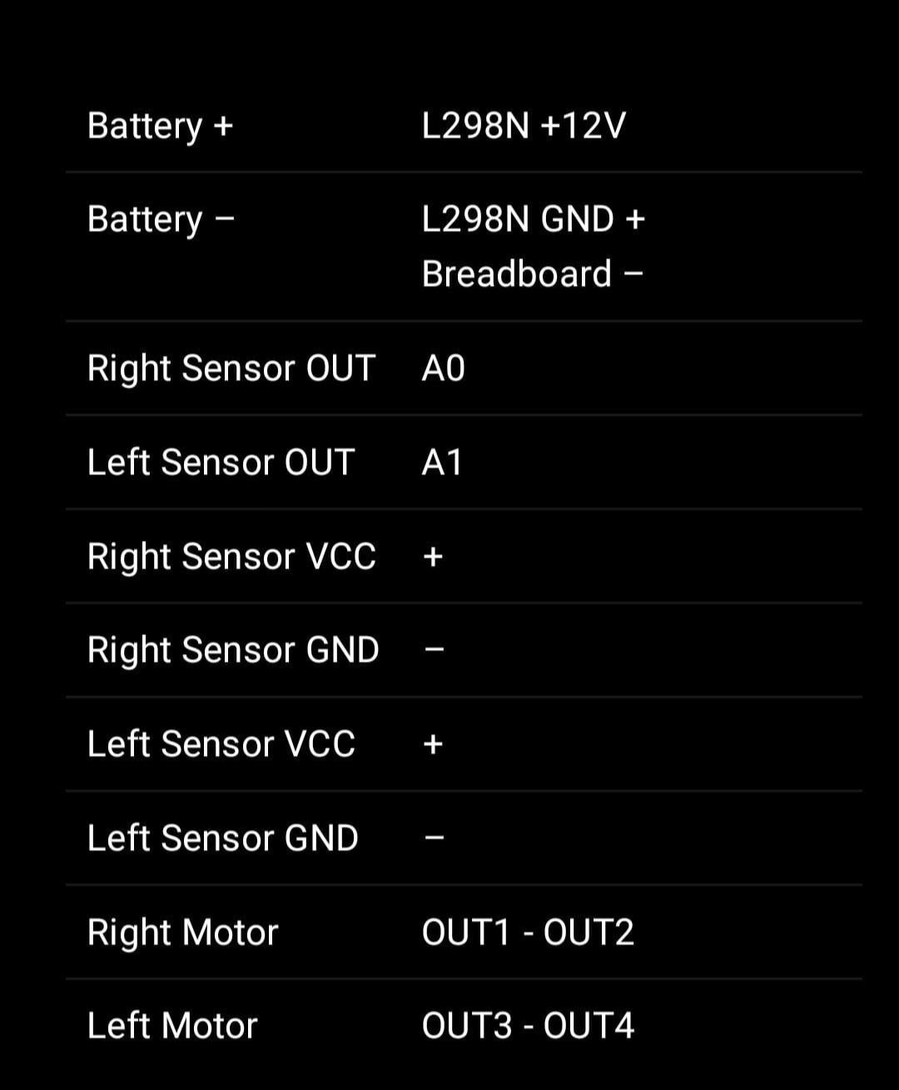
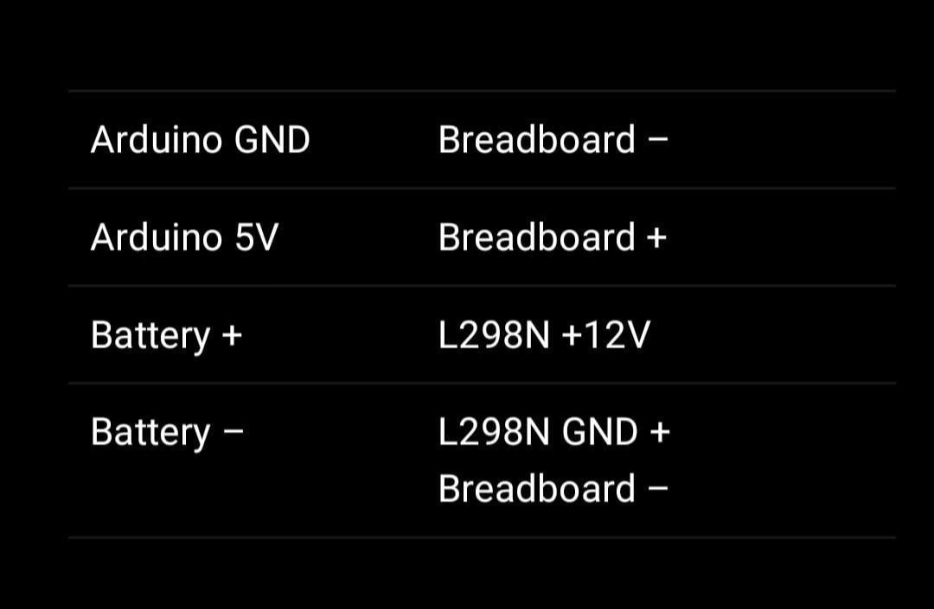
Wire connection

Slide 16
Wire connection

Slide 17
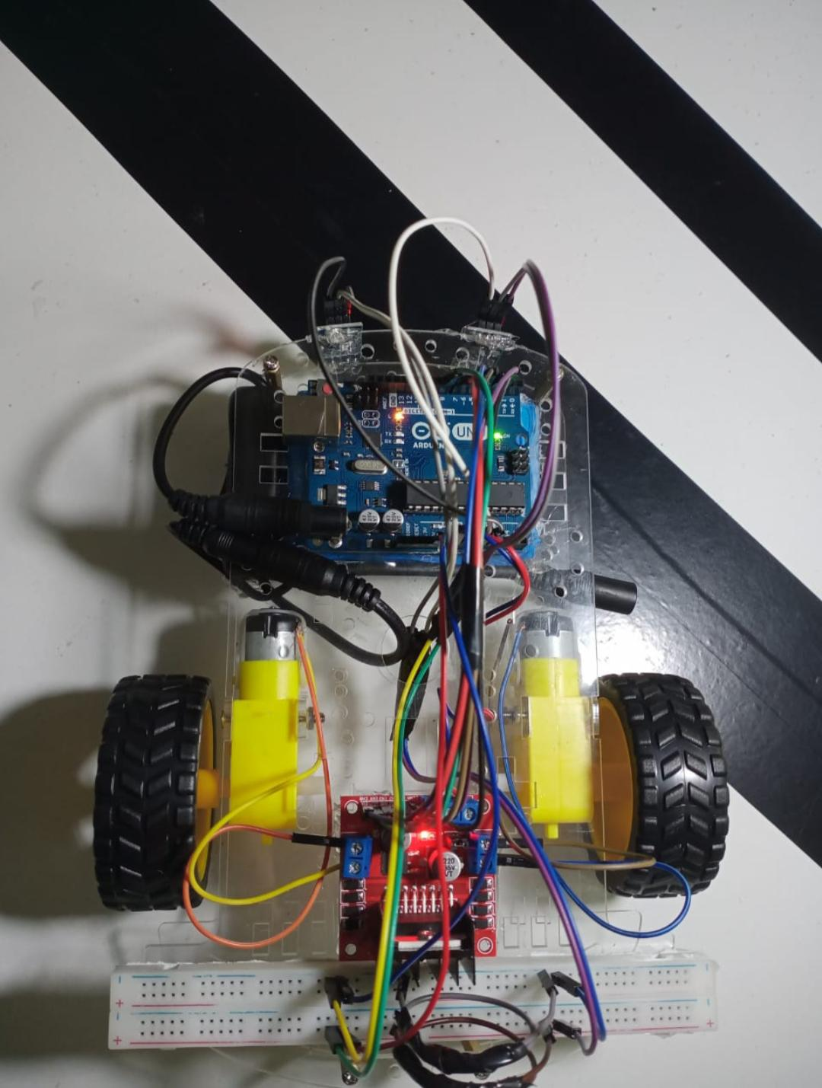
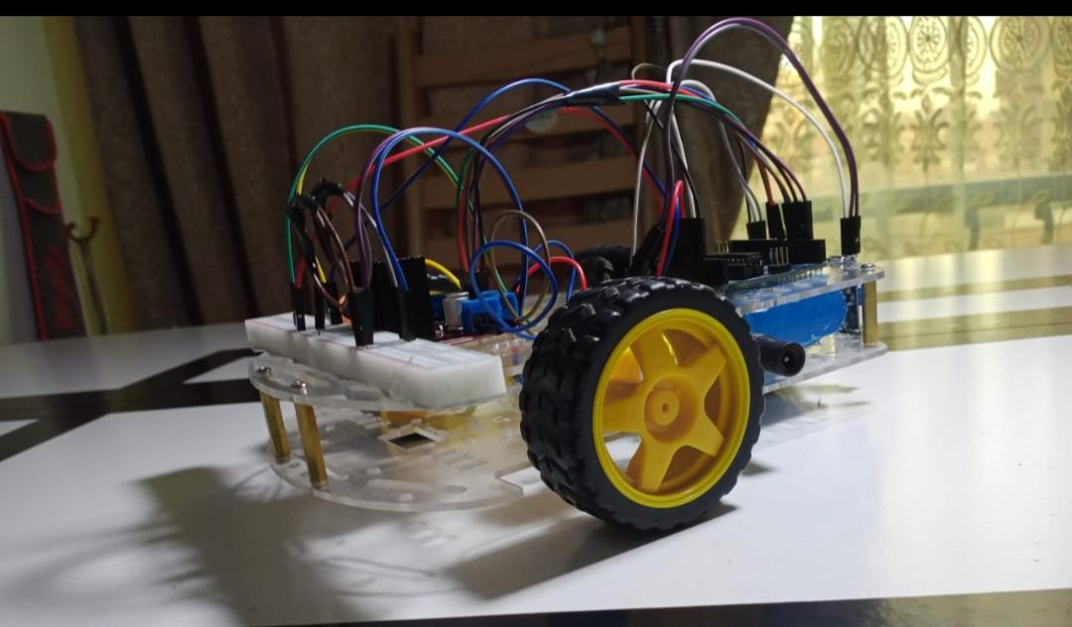


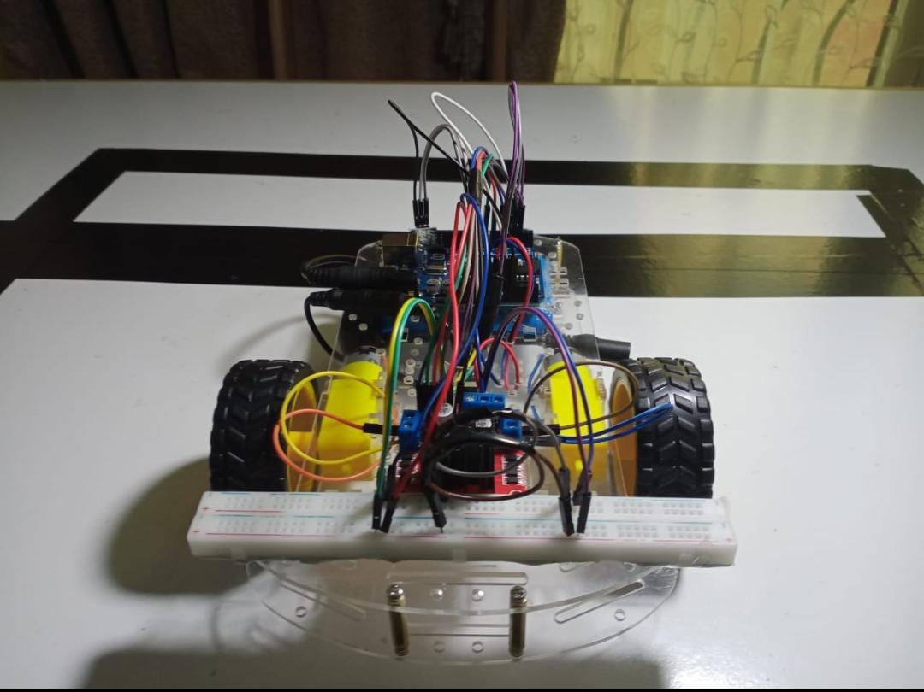
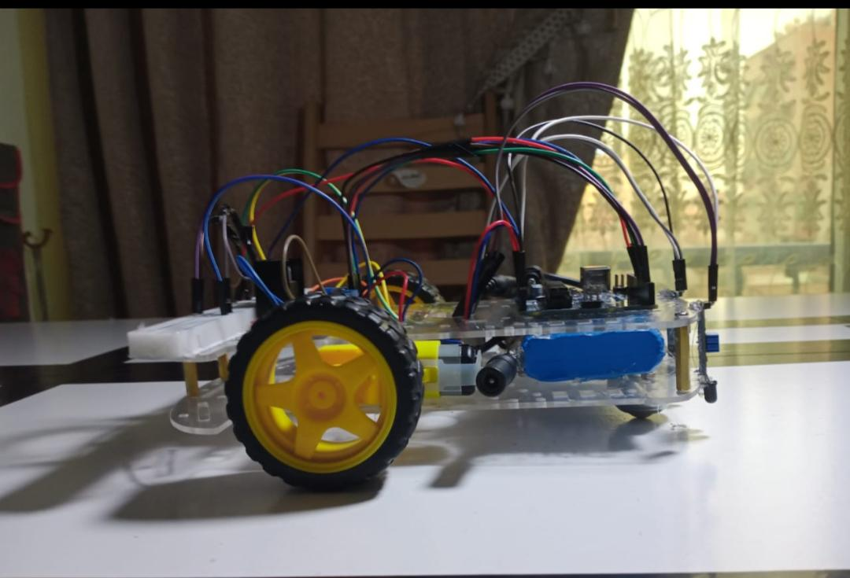




Slide 20
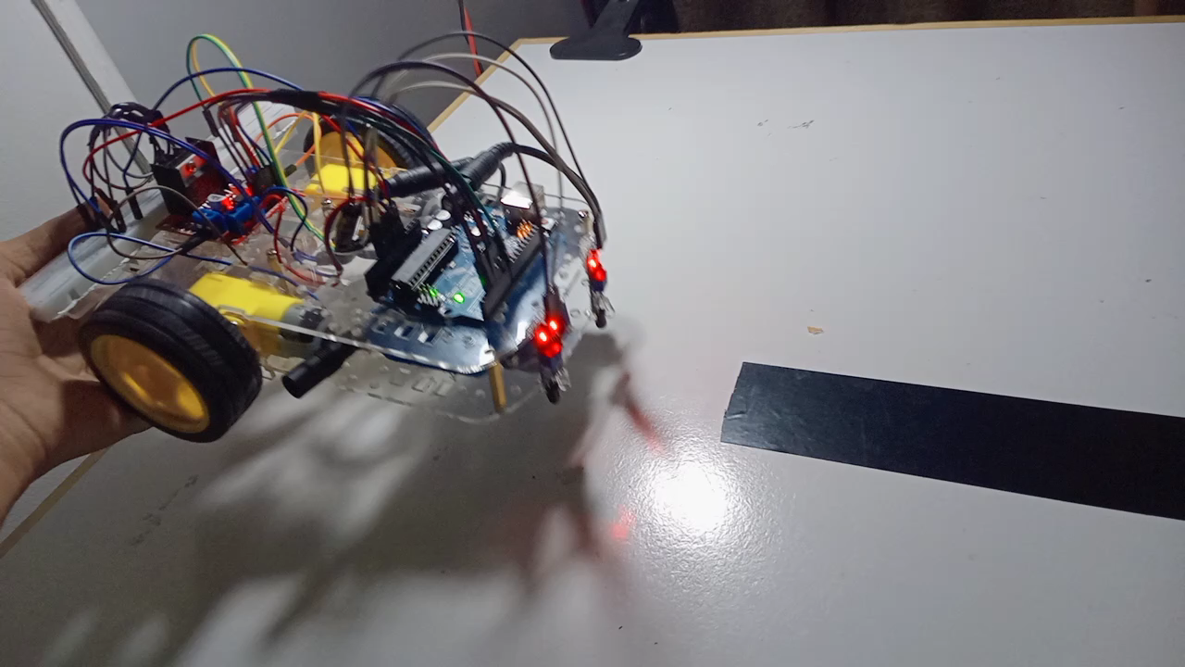

Slide 21
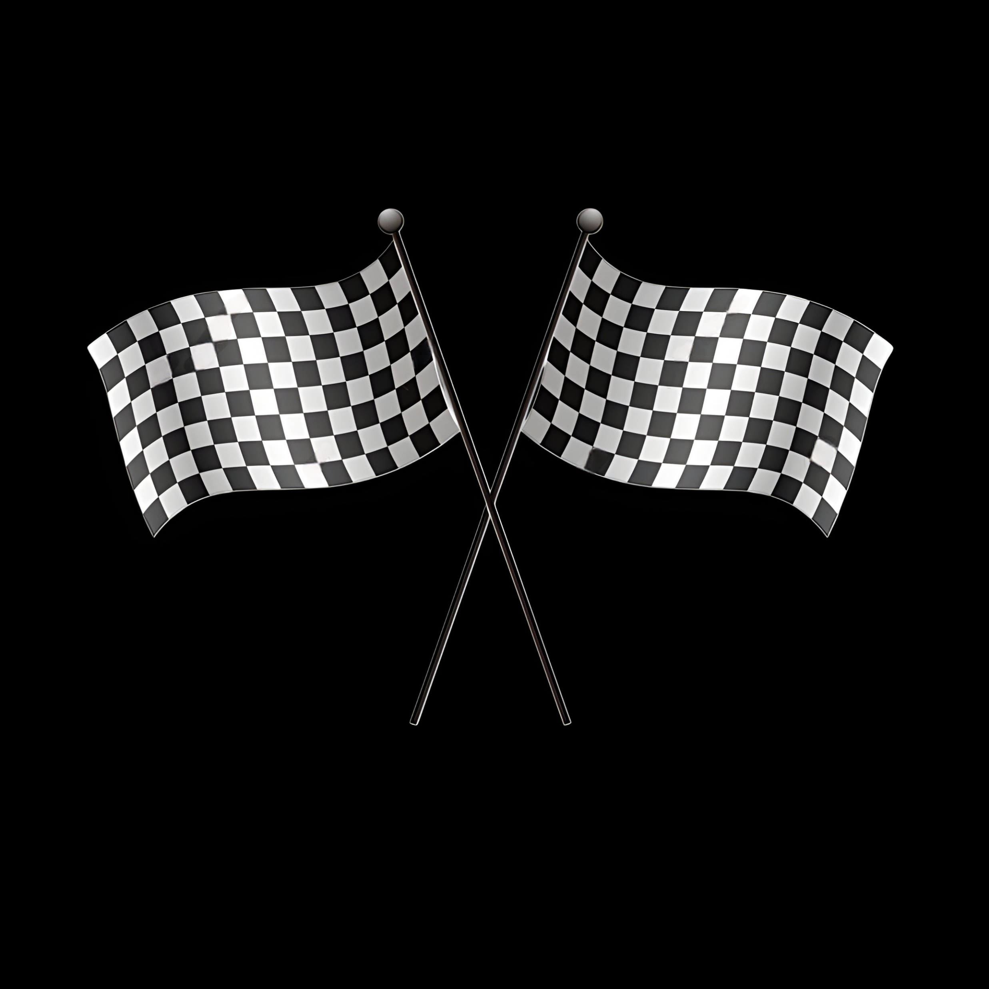
Finish
Thank you

